Slide 1
MySQL JOINS
JOINS ARE USED TO RETRIEVE THE DATA FROM TWO OR MORE TABLES based on a common column between them !
By Aman Tiwari

Slide 2
Types of Joins in MySQL
1.CROSS JOIN (comma join)
2.INNER JOIN
3.OUTER JOINS
( a. LEFT [OUTER] JOIN b. RIGHT [OUTER] JOIN c. FULL OUTER JOIN )
4. joins
i) Joins with USING clause
ii) Joins with the ON clause
5.SELF JOIN

Slide 3
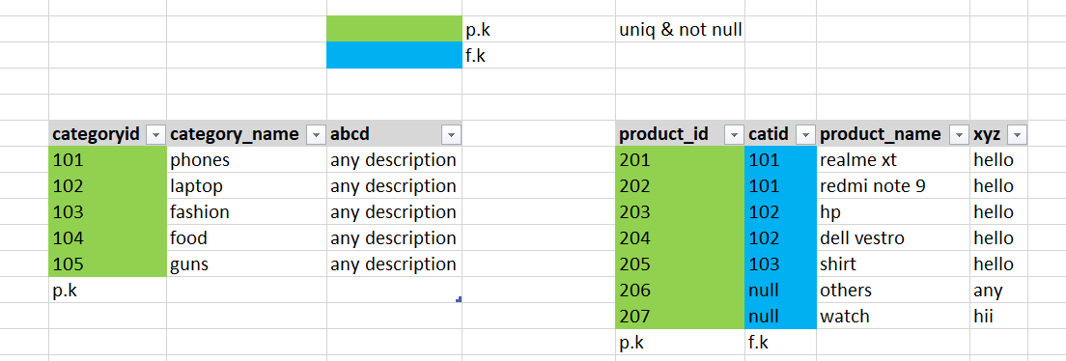
Let I have 2 tables products and categories

Slide 4
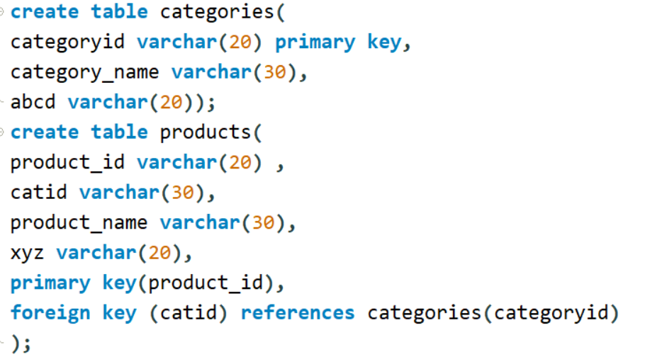
Table Creation Query

Slide 5
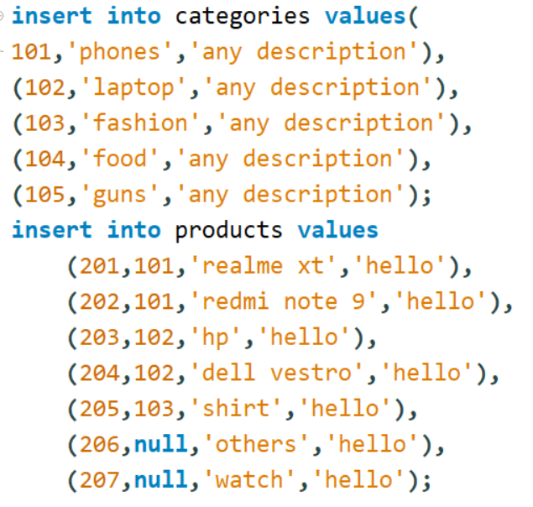
Insert query

Slide 6
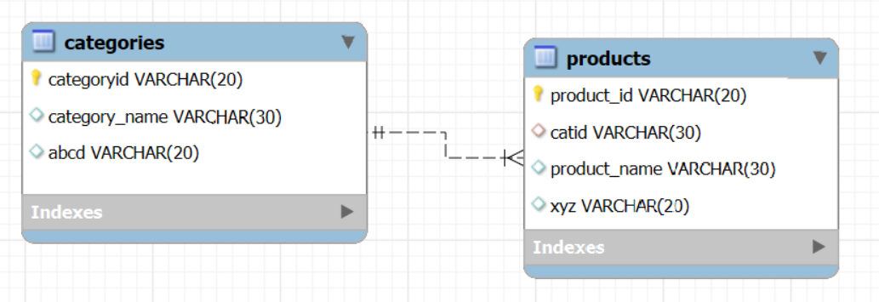
Enhanced Entity Relationship Diagram(EER)

Slide 7
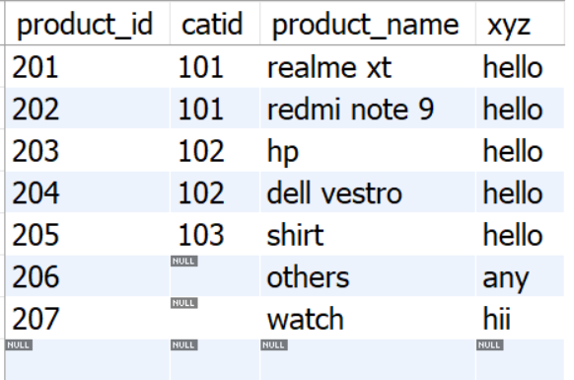
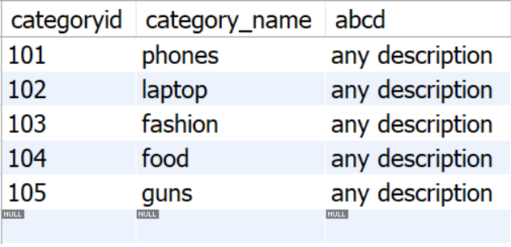
Products and Categories table

Slide 8
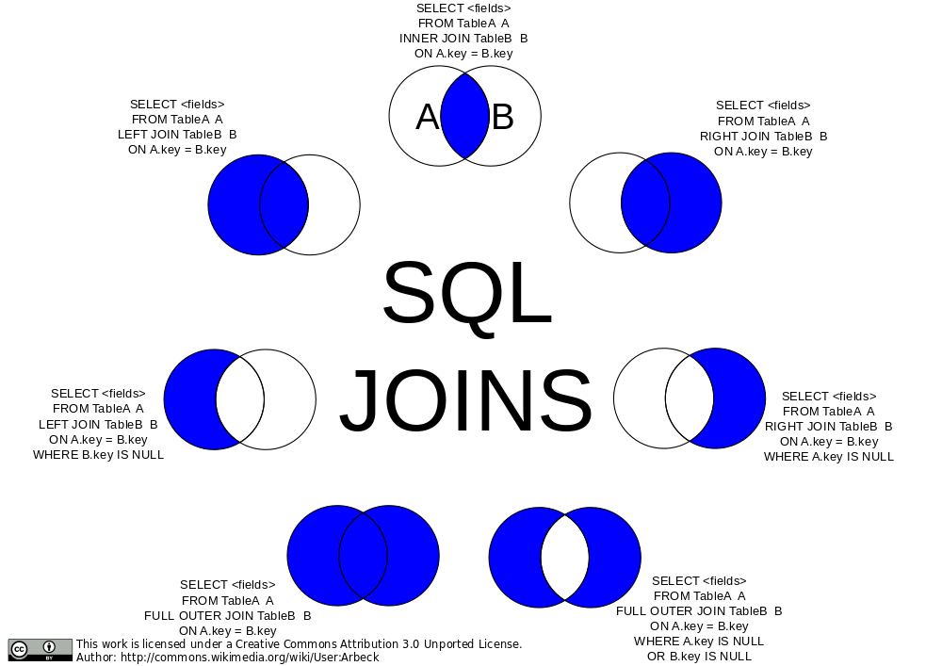

Slide 9
Notes :
There is no difference between RIGHT JOIN and RIGHT OUTER JOIN. Both are the same.
That means that LEFT JOIN and LEFT OUTER JOIN are the same.
Products table is considered as Left table and Categories Table is Considered as Right table in our Tutorial.
It is not compulsory that every product must lie in a category (that’s why foreign key also accepts multiple null values )
You cannot use using clause instead of on clause because our column name is different in both the tables
Full outer join is not supported in MySQL

Slide 10
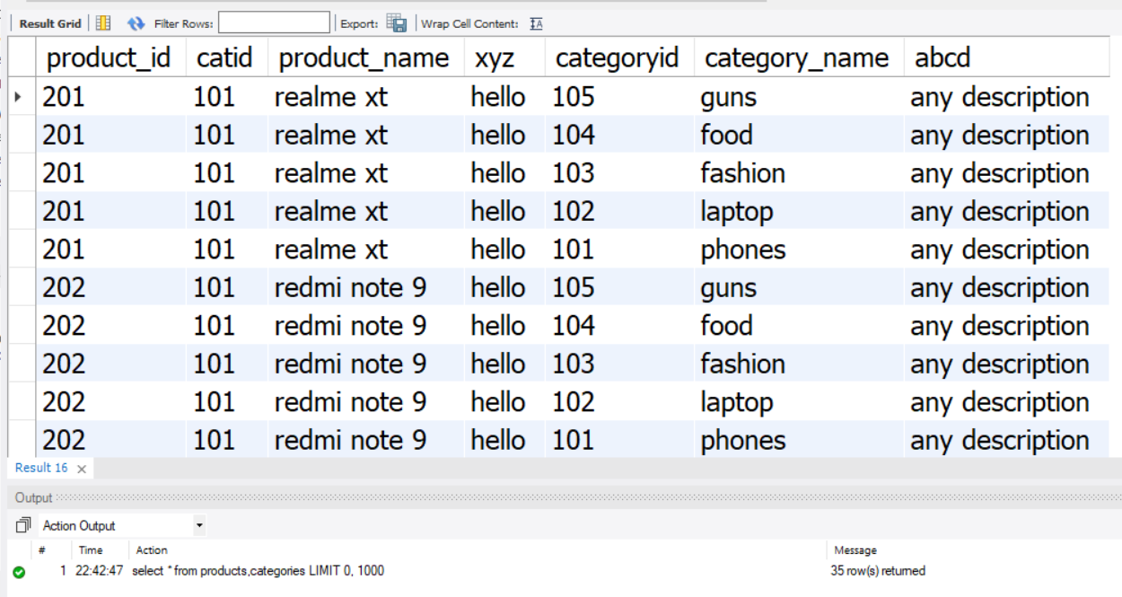
Cross join , Cartesian Product,Comma join
This means , each and every row in the first table is joined to each and every row in the second table.
select * from products cross join categories;
select * from products join categories;
select * from products,categories;

Slide 11
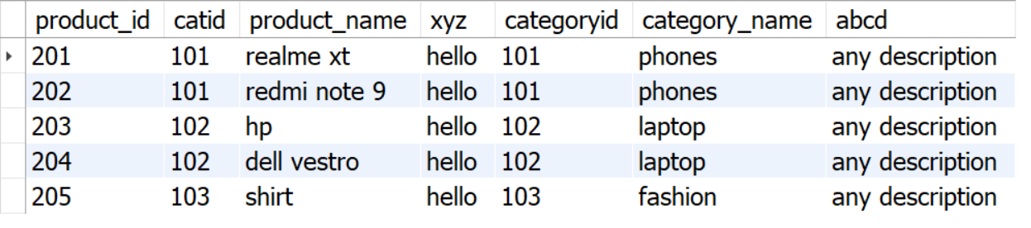
Inner Join (gives matching data from 2 or more tables)
select * from products p
inner join categories c
on p.catid=c.categoryid;

Slide 12
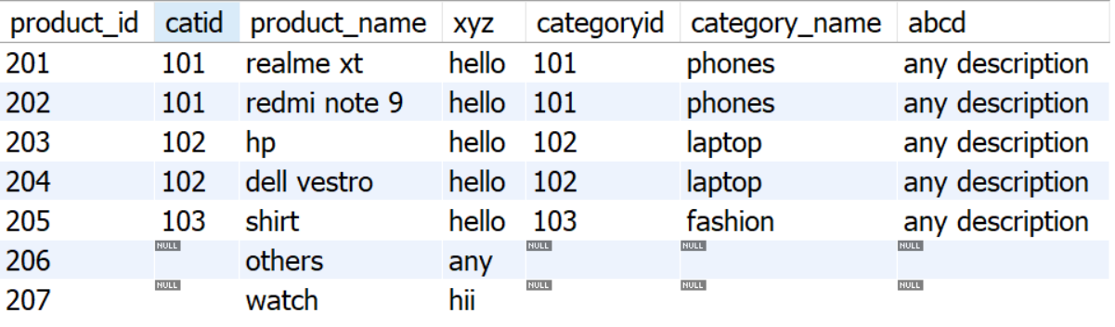
Left join
select * from products p
left join categories c
on p.catid=c.categoryid;
This selected all the data from Left table including null value in catid(products table)
And all the unmatched data from right table became null while the data for unmatched column is present in our database.

Slide 13
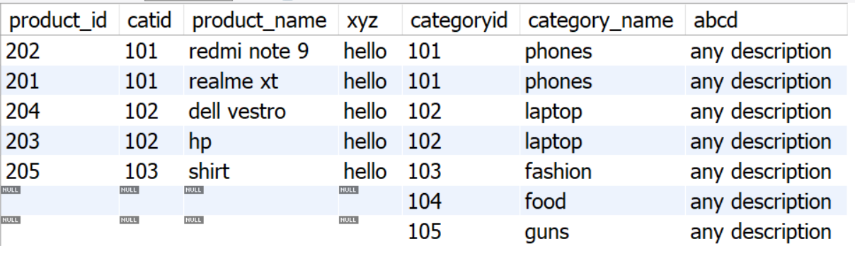
Right join
select * from products p
right join categories c
on p.catid=c.categoryid;
This selected all the data from Right table And all the unmatched data from left table became null while the data for unmatched column is present in our database.

Slide 14
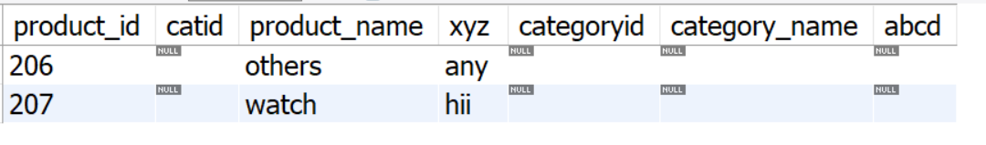
Only Left (excluding common data from left table)
select * from products p
left join categories c
on p.catid=c.categoryid
where c.categoryid is null;
This query gives all the data of that products which doesn’t belongs to any category in categories table

Slide 15
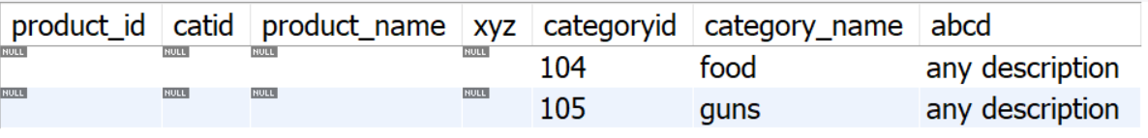
Only Right (excluding common data from right table)
select * from products p
right join categories c
on p.catid=c.categoryid
where p.catid is null;
This query gives all the data of that category which doesn’t belongs to any product in products table

Slide 16
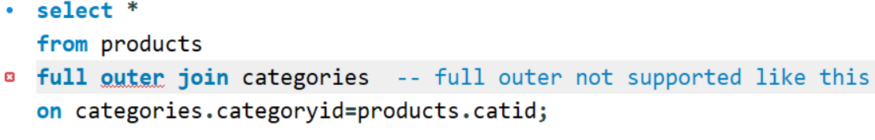
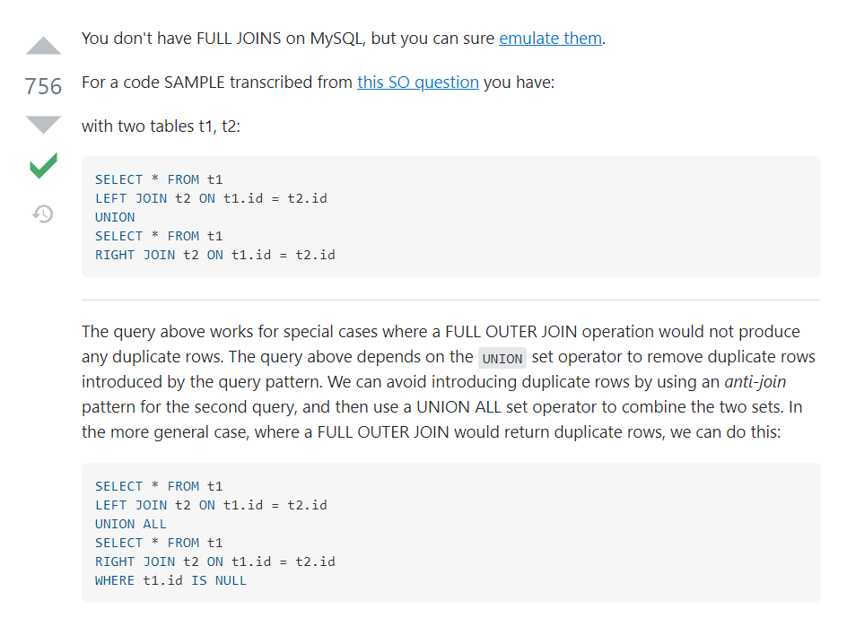
Full Outer
( it gives all the data
from 2 or more tables )

Slide 17
Union
select *from products p
left join categories c
on p.catid=c.categoryid
union
select *from products p
right join categories c
on p.catid=c.categoryid;

Slide 18
Union All
select *from products p
left join categories c
on p.catid=c.categoryid
union all
select *from products p
right join categories c
on p.catid=c.categoryid;

Slide 19
Creating new Table (UserInfo)
create table user_info(userid int primary key auto_increment,
username varchar(20),password varchar(20),productid varchar(20),
foreign key(productid) references products(product_id));
insert into user_info(username,password,productid) values('aman','123','201'),('rohan','456','203'),('rohit','789','204');

Slide 20
Joining multiple tables
select * from products p
inner join categories c
on p.catid=c.categoryid
inner join user_info u
on u.productid=p.product_id;
select * from categories c
inner join products p
on p.catid=c.categoryid
inner join user_info u
on u.productid=p.product_id;

Slide 21
Joining through Using Clause
alter table user_info rename column productid to product_id;
select * from user_info;
select * from products p
inner join user_info u
-- on p.product_id=u.product_id;
using (product_id); -- no duplicate key column arrived
when column name is same use using clause otherwise use on clause

Slide 22
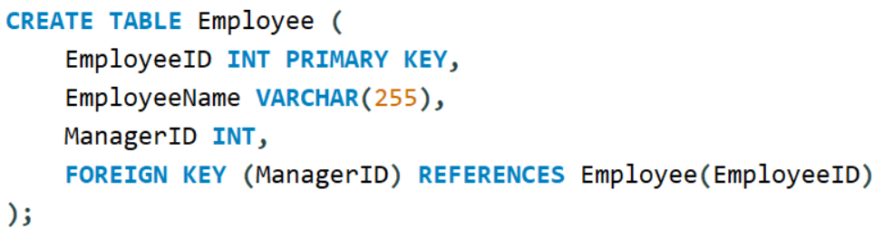
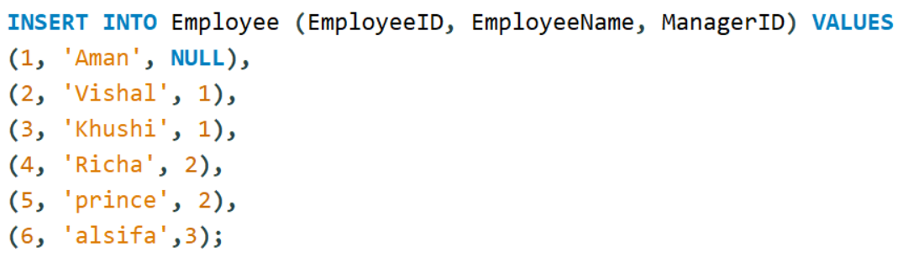
Self Join

Slide 23
